Slide 1
NMNN No More Nerd Neck
The Graduate Project by Jin Woo Jung

Slide 2


Intro
Increased Computer Usage
Global Internet usage
increased by 30% in March
...Influence of COVID-19.
Many neck patients
75% of the population will experience neck pain some time in their lives
How to relieve tech neck
Keep right posture not to strain your spine
Stretch to relax your muscles

Slide 3
Project Overview
01
Recognition
distinguishes between the right posture and the tech neck posture.
02
Alert
let you know when you become wrong posture with notification sound
03
Correction
provide a stretching guide video to relieve your neck stress

Slide 4
Background / Motivation
aaa
aaa
01
02
abc
abc
aaa
aaa
03
04
abc
abc
aaa
aaa
05
06
abc
abc

Slide 5
System Design
Web Client
Model Building
Visualization
Sign in
Camera
access
Recog. modeling
Screen
Count/
Alert
Web Server
External APIs
Data
Screen
User
data
Guide
VOD

Slide 6
Progress
01
02
03
Model
Building
Data
Cleansing
Visualization
Data addition
from update
to deletion
Recognize
the correct posture and tech neck posture
In progress

Slide 7
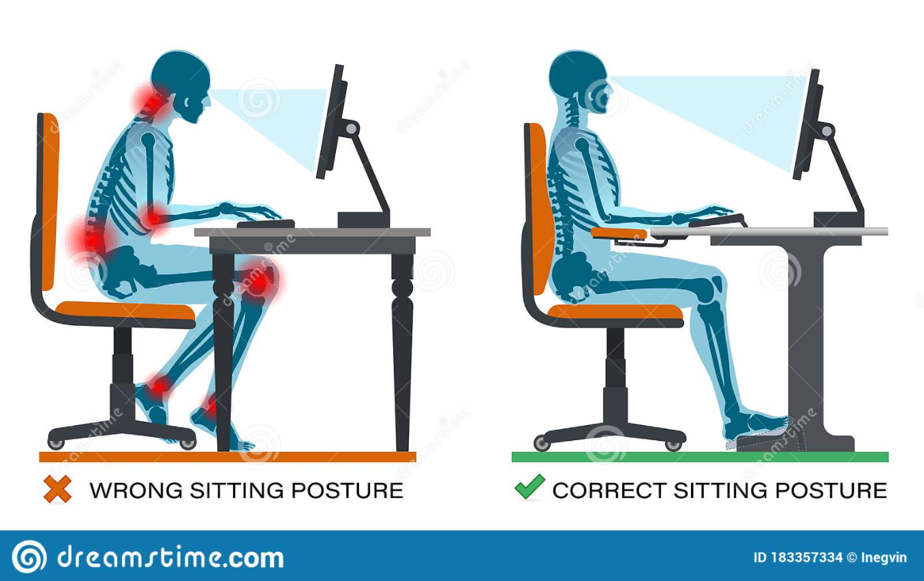

Slide 8
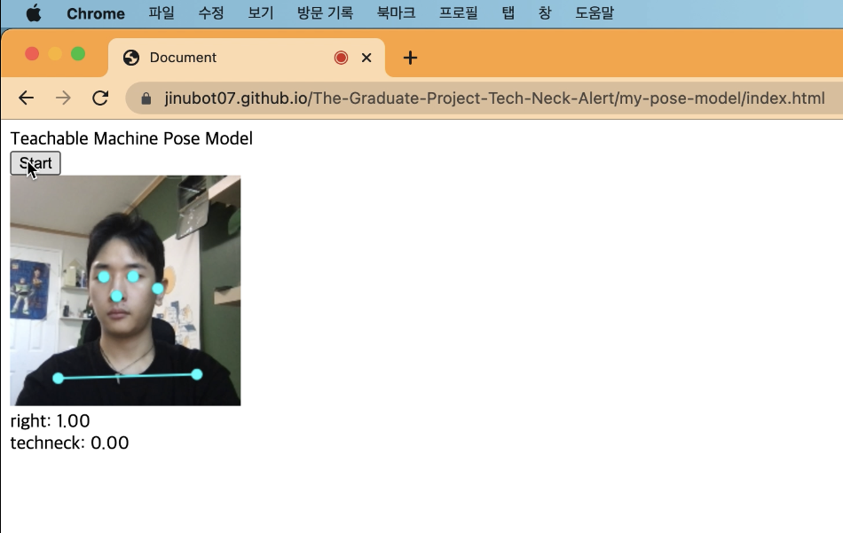
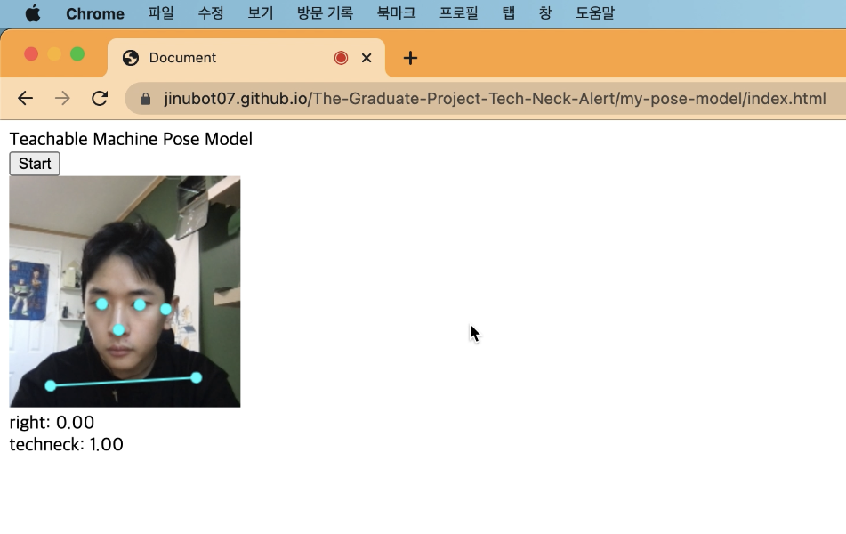
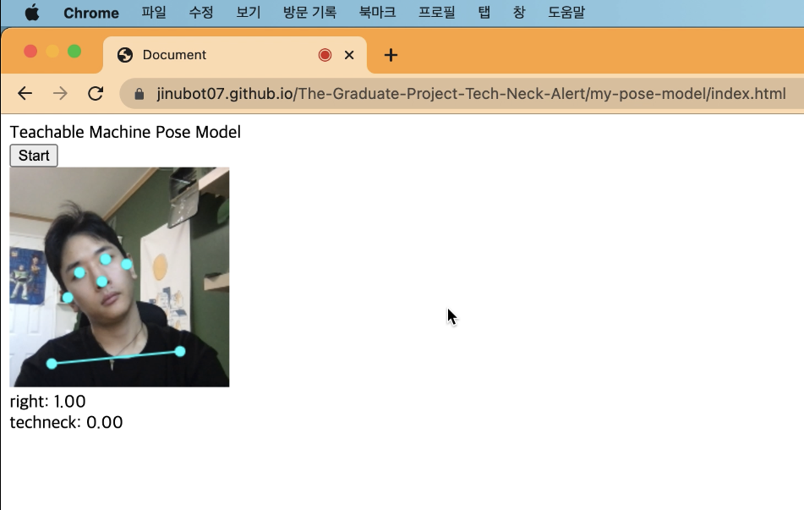
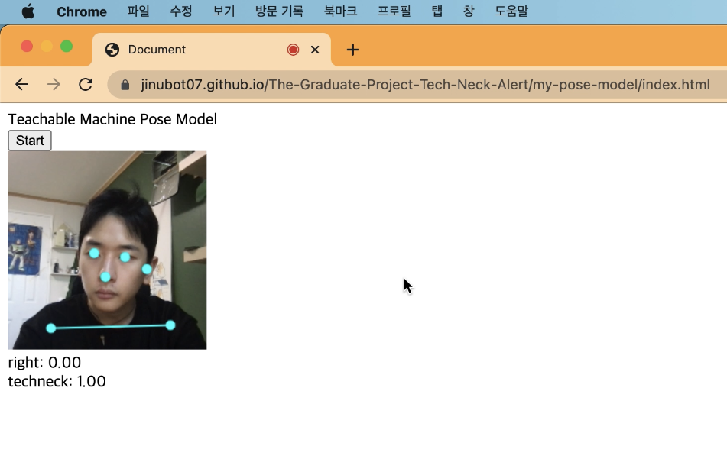

Slide 9
Plan
Alert
Give an alarm to let user know
Saving
remember users’ data to check their routine
Web deploy
Allow to use the service anytime, anywhere
Demo
Various data to increase the recognition rate

Slide 10
Plan
Alert
Give an alarm to let user know
20%
Saving
remember users’ data to check their routine
30%
Web deploy
Allow to use the service anytime, anywhere
10%
Demo
Various data to increase the recognition rate
40%

Slide 11
Reference / Source
https://www.yna.co.kr/view/AKR20200407061100017
http://www.healtip.co.kr/news/articleView.html?idxno=2840
https://ergonomictrends.com/shocking-neck-pain-and-text-neck-stats/
https://www.youtube.com/watch?v=dJjzTo8_x3c
http://www.j2aircraft.com/application-benefits/complete-system-design/
https://www.semanticscholar.org/paper/The-design-and-implementation-of-intelligent-system-Xie/fde44758f0297c2b9c5a5fb93598ec2edc91d953
Thank you

Slide 12
Reference / Source
https://www.yna.co.kr/view/AKR20200407061100017
http://www.healtip.co.kr/news/articleView.html?idxno=2840
https://ergonomictrends.com/shocking-neck-pain-and-text-neck-stats/

Slide 13
Data Privacy Infographics
Check URL
Privacy settings
Post with care
Venus has a beautiful name, but it's hot
Mercury is the closest planet to the Sun
Neptune is the farthest planet from the Sun

Slide 14
Data Privacy Infographics
03
02
01
Safe browsing
Privacy on
Venus is the second planet from the Sun
Personal info
Mercury is the closest planet to the Sun
Saturn is the ringed one. It’s a gas giant

Slide 15
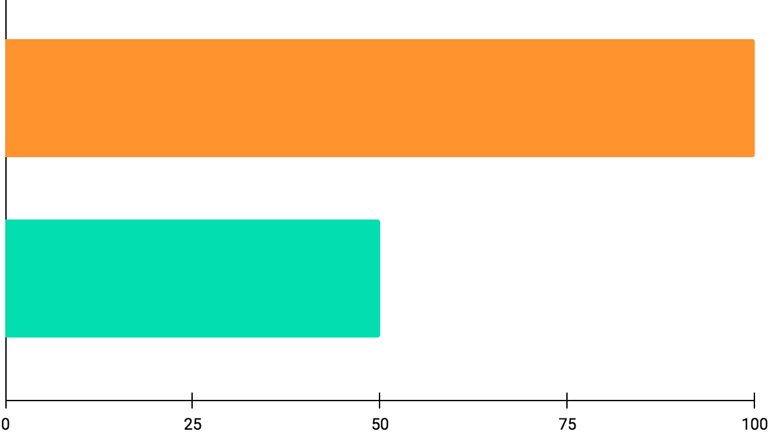
Data Privacy Infographics
100%
Mars
Despite being red, Mars is a cold place
50%
Venus
Venus has a beautiful name, but it's hot
Follow the link in the graph to modify its data and then paste the new one here. For more info, click here

Slide 16
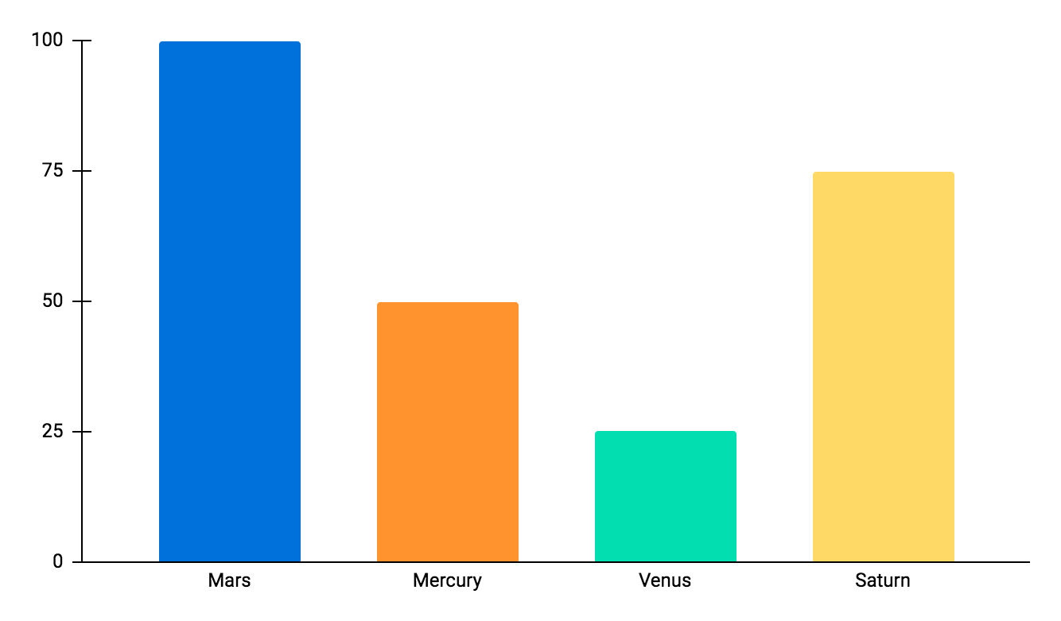
Data Privacy Infographics
100%
50%
Mercury
Neptune
Mercury is the closest planet to the Sun
Neptune is the farthest planet from the Sun
25%
75%
Venus
Pluto
Venus has a beautiful name, but it's hot
Pluto is now considered a dwarf planet
Follow the link in the graph to modify its data and then paste the new one here. For more info, click here

Slide 17
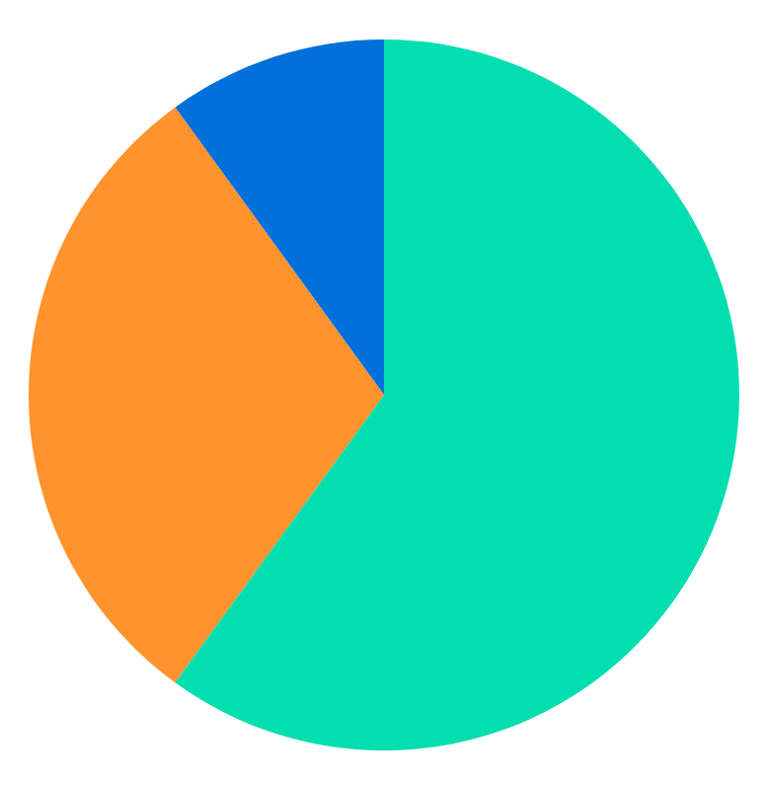
Data Privacy Infographics
Mercury
Neptune
20%
10%
Mercury is the closest planet to the Sun
Neptune is the farthest planet from the Sun
Venus
40%
Venus has a beautiful name, but it's hot
Follow the link in the graph to modify its data and then paste the new one here. For more info, click here

Slide 18
Data Privacy Infographics
Mars
Mercury
Despite being red, Mars is a very cold place
Mercury is the closest planet to the Sun
Venus
Jupiter
Venus has a beautiful name, but it's hot
Jupiter is the biggest planet of them all

Slide 19
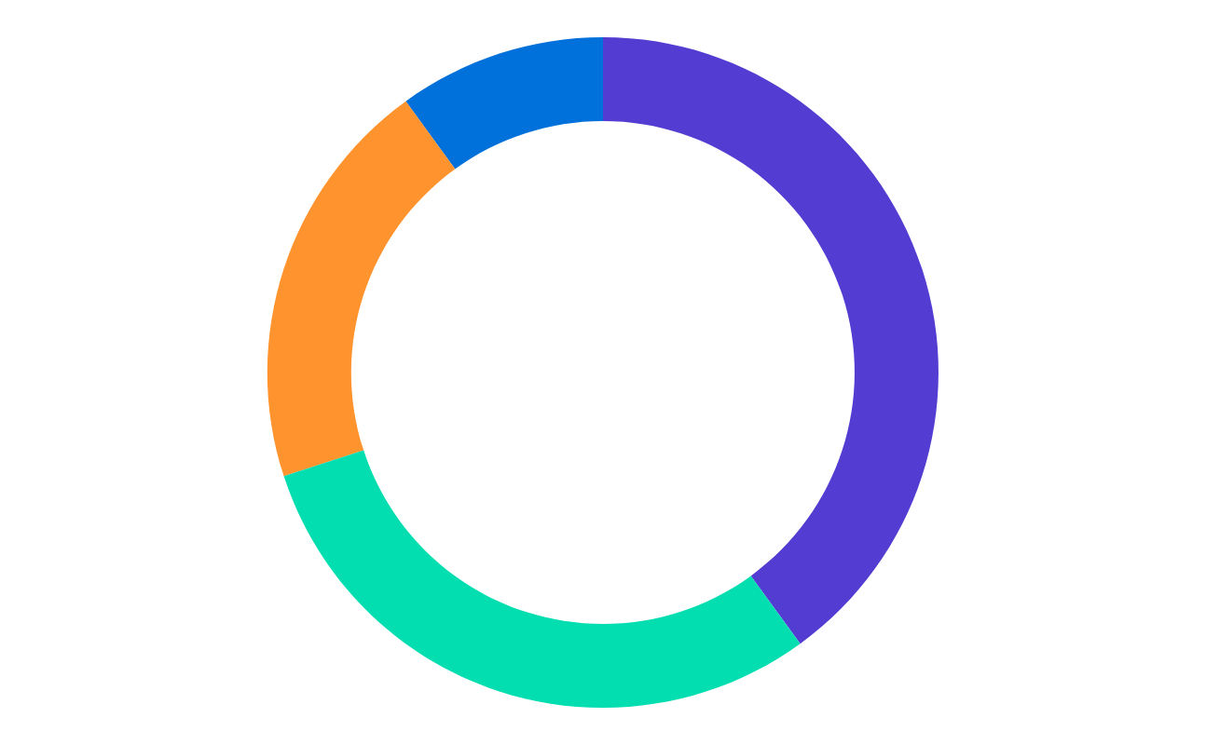
Data Privacy Infographics
10%
40%
Mercury
Neptune
Mercury is the closest planet to the Sun
Neptune is the farthest planet from the Sun
20%
30%
Venus
Pluto
Venus has a beautiful name, but it's hot
Pluto is now considered a dwarf planet
Follow the link in the graph to modify its data and then paste the new one here. For more info, click here

Slide 20
Data Privacy Infographics
Update
Password
Settings
Firewall
Network
Mercury is the smallest planet
Despite being red, Mars cold
Jupiter is the biggest planet
Neptune is very far from the Sun
Venus has a toxic atmosphere

Slide 21
Data Privacy Infographics
50%
75%
Mars
Jupiter
Despite being red, Mars is a cold place
Jupiter is a gas giant and the biggest planet
50%
75%
Mercury
Venus
Mercury is the closest planet to the Sun
Venus has a beautiful name, but it's hot

Slide 22
Data Privacy Infographics
30%
Mercury
01
Mercury is the closest planet to the Sun
40%
Venus
02
Venus has a beautiful name, but it's hot
70%
Earth
03
The Earth is the only planet that harbours life

Slide 23
Data Privacy Infographics
01
Mercury
Mars
02
Mercury is the smallest planet of them all
Despite being red, Mars is actually a very cold place
03
Venus
Jupiter
04
Venus has a beautiful name and high temperatures
It is a gas giant and the biggest planet of them all
05
Earth
Saturn
06
The Earth is the only planet that harbors life
Saturn is a gas giant and has several rings

Slide 24
Data Privacy Infographics
01
02
03
04
Mercury
Mars
Jupiter
Neptune
It is the closest planet to the Sun
Despite being red, Mars is a cold place
It is a gas giant and the biggest planet
It is the farthest planet from the Sun

Slide 25
Data Privacy Infographics
Mercury
Neptune
02
03
Mercury is the closest planet to the Sun
Neptune is the farthest planet from the Sun
Venus
Pluto
01
04
Venus has a beautiful name, but it's hot
Pluto is now considered a dwarf planet

Slide 26
Data Privacy Infographics
Mercury
Neptune
It is the closest planet to the Sun
The farthest one from the Sun
Mars
Jupiter
Venus
Despite being red, Mars cold
It is the biggest planet of them all
It has a nice name but is hot

Slide 27
Data Privacy Infographics
01
02
03
Private password
Privacy settings
Antivirus
The Earth is the only planet that harbors life
Venus has a beautiful name and high temperatures
Mercury is the smallest planet of them all

Slide 28
Data Privacy Infographics
45%
55%
Mercury
Venus
Mercury is the closest planet to the Sun
Venus has a beautiful name, but it's hot

Slide 29
Data Privacy Infographics
Secure VPN
Download carefully
Strong passwords
The Earth is the only planet that harbors life
Venus has a beautiful name and high temperatures
Mercury is the smallest planet of them all

Slide 30
Data Privacy Infographics
01
02
03
Check URL
Check email
Log out
The Earth is the only planet that harbours life
Venus has a beautiful name and high temperatures
Mercury is the smallest planet of them all

Slide 31
Data Privacy Infographics
Phishing
Mercury is the closest planet to the Sun and the smallest one in the entire Solar System
Websites
Social Media
Email
Mobile Apps

Slide 32
Data Privacy Infographics
Venus
Pluto
01
02
Venus has a beautiful name, but it's hot
Pluto is now considered a dwarf planet
Earth
Ceres
03
04
The Earth is the only planet that harbours life
Ceres is located in the main asteroid belt

